Slide 1
Introduction to Test Case
Emp Id - 6162

Slide 2
What is Test Case?
The test case is defined as a group of conditions under which a tester determines whether a software application is working as per the customer's requirements or not.

Slide 3
When do we write a test case
When the customer gives the business needs then, the developer starts developing and says that they need 3.5 months to build this product.
And In the meantime, the testing team will start writing the test cases.
Once it is done, it will send it to the Test Lead for the review process.
And when the developers finish developing the product, it is handed over to the testing team.
The test engineers never look at the requirement while testing the product document because testing is constant and does not depends on the mood of the person rather than the quality of the test engineer.

Slide 4
Why we write the Test case?
To require consistency in the test case execution
To make sure a better test coverage
It depends on the process rather than on a person
To avoid training for every new test engineer on the product

Slide 5
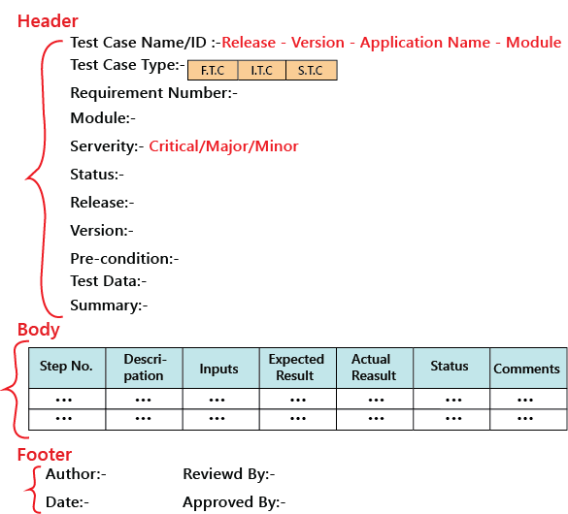
Test Case Template

Slide 6
Types of test cases
Functional test cases
Integration test cases
System test cases

Slide 7
Functional Test Case
In functional testing or if the application is data-driven, we require the input column else; it is a bit time-consuming.

Slide 8
Integration Test Case
We should not write something which we already covered in the functional test cases, and something we have written in the integration test case should not be written in the system test case again.

Slide 9
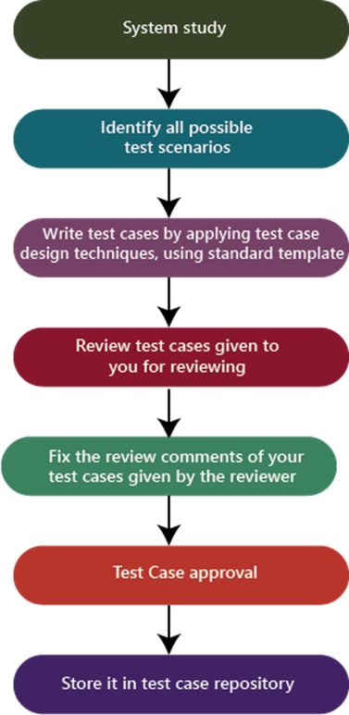
System Test Case

Slide 10
Performance Test Cases
Performance test cases validate response times and overall effectiveness of an application. That is, after executing an action, how long does it take for the system to respond? Performance test cases should have a very clear set of success criteria.

Slide 11
Thank You

